Slide 1
Online Food Delivery System (Friendly Café)
Get Food Delivered at your Door Step

Slide 2
TEAM MEMBERS
2583380 Siddhartha Raj - TL
2582645 Sourabh R Kurne
2583161 Subham Kumar Pandit
2583462 Uppaluri Venkata Syamala Rajyasree
2582878 Vema Prudhvi Sai
2583274 Vinita X
2583569 Vishwanath Havaldar
2583521 Yarrajeni Divya Sri

Slide 3


Slide 4
ABSTRACT INTRODUCTION OBJECTIVE TECHNOLOGY

Slide 5
ABSTRACT
In this project, we have created a full stack web application called Friendly Cafe, an Online Food Delivery System.
We have used springboot for backend, angular for frontend and mysql for database.
In this, user can signup/login and order foods through online payment.
Admin can login and do all the crud operation on products, customer and purchases.

Slide 6
INTRODUCTION
The "Online Food Delivery System" has been developed to override the problems prevailing in the practicing manual system Moreover, this system is designed for the particular need of the company to carry out operations in a smooth and effective manner.
The application is reduced as much as possible to avoid errors while entering the data. It also provides error message while entering invalid data. Thus, by this all it proves it is user-friendly.
Every organization, whether big or small, has challenges to overcome and managing the information of Category, Food Item, Order, Payment, Confirm Order.

Slide 7
OBJECTIVE
To provide a bug-free Online Food Delivery system to Users as well as Admin.
The main objective is here to provide a nice and secure platform for Ordering Food.
To maintain the records of Product, Category available into the system

Slide 8
Tools/Technologies
Front End - Angular
Backend - SpringBoot
Database - MySQL,Hibernate

Slide 9
Spring boot
Spring Boot is a Java framework, built on top of the Spring, used for developing web applications.
Spring Boot is a backend framework that has become a major player in the enterprise Java EE.
No requirement for complex XML configurations.
It allows you to create REST APIs with minimal configurations.

Slide 10
Angular
Angular is a TypeScript-based free and open-source web application framework lead by the Angular Team at google and by a community of individuals and corporations. Angular is a complete rewrite from the same team that built Angular js.
Angular is a JavaScript (actually a TypeScript based open-source full-stack web application) framework which makes you able to create reactive Single Page Applications (SPAs). Angular is completely based on components. It consists of several components which forms a tree structure with parent and child components.

Slide 11
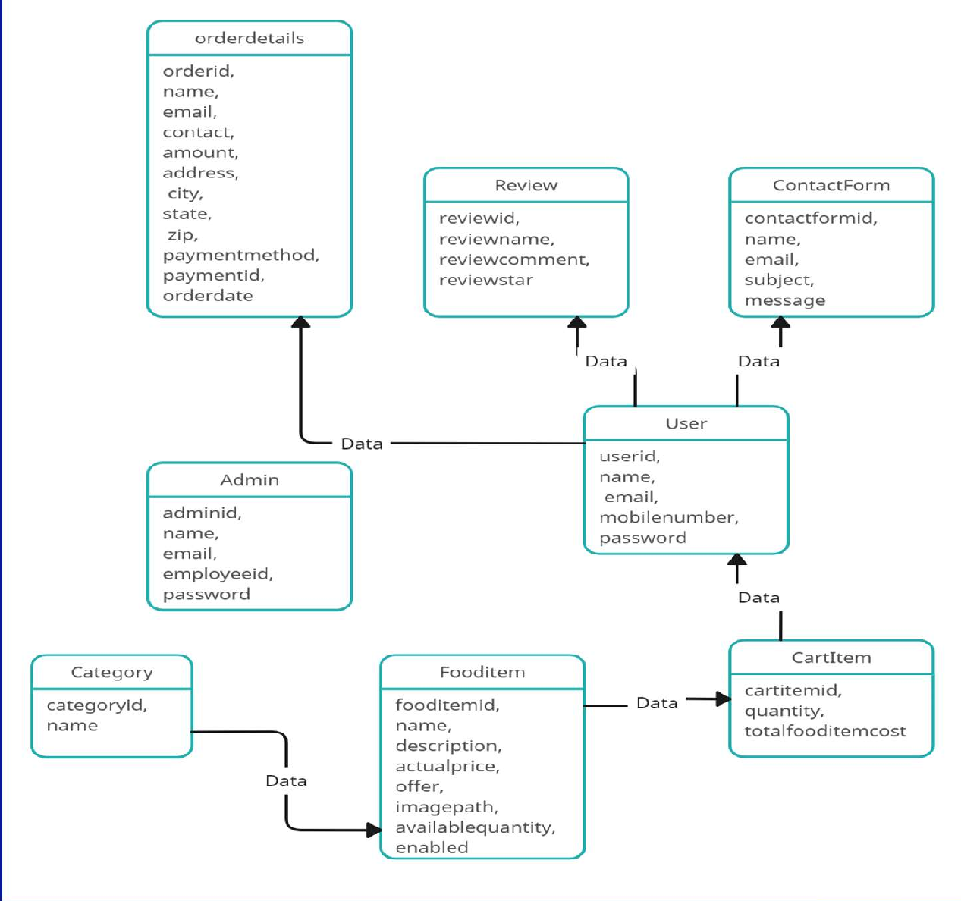
ER DAIGRAM

Slide 12
Thank you

